Slide 1
Karnaugh map
It is an alternative to the truth-table form for representing a function. The map consists of cells that correspond to the rows of the truth table.
it allows easy recognition of minterms that can be combined

Slide 2
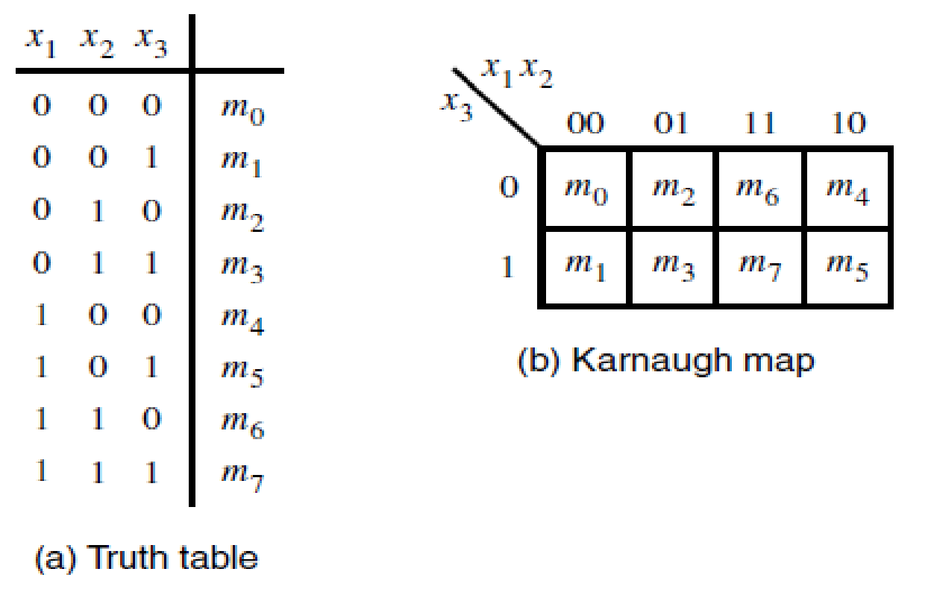
Three-Variable Map

Slide 3
Minterms in any two cells that are adjacent, either in the same row or the same column, can be combined.
The adjacent cells must differ in the value of only one variable.
Thus the columns are identified by the sequence of (x1, x2) values of 00, 01, 11, and 10.

Slide 4
This makes the second and third columns different only in variable x1. Also, the first and the fourth columns differ only in variable x1, which means that these columns can be considered as being adjacent. (A sequence of codes, or valuations, where consecutive codes differ in one variable only is known as the Gray code.)

Slide 5
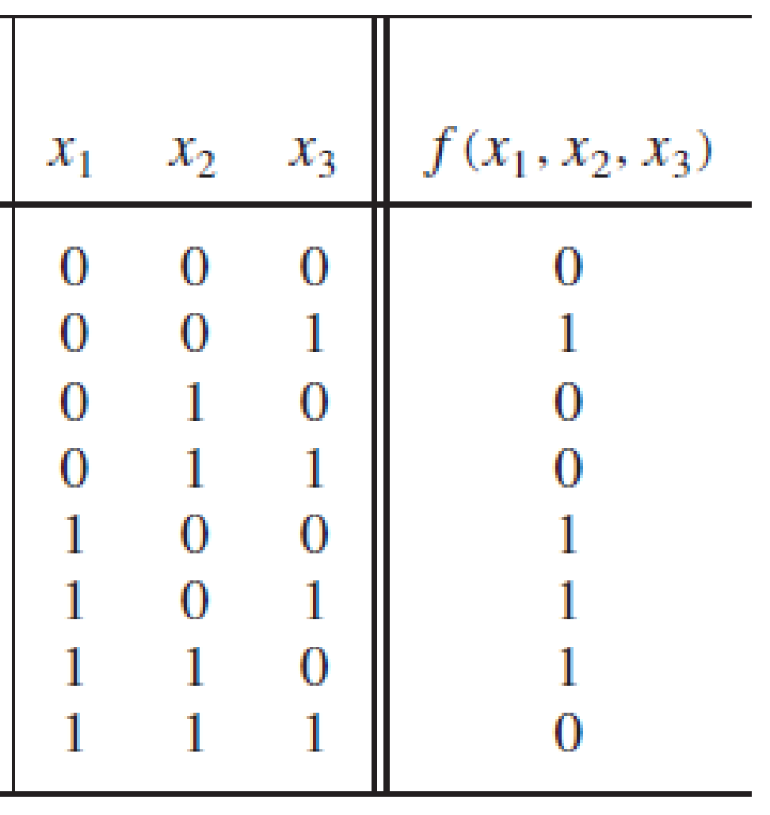
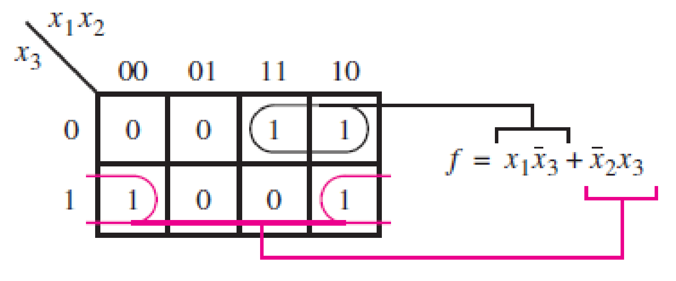

Slide 6
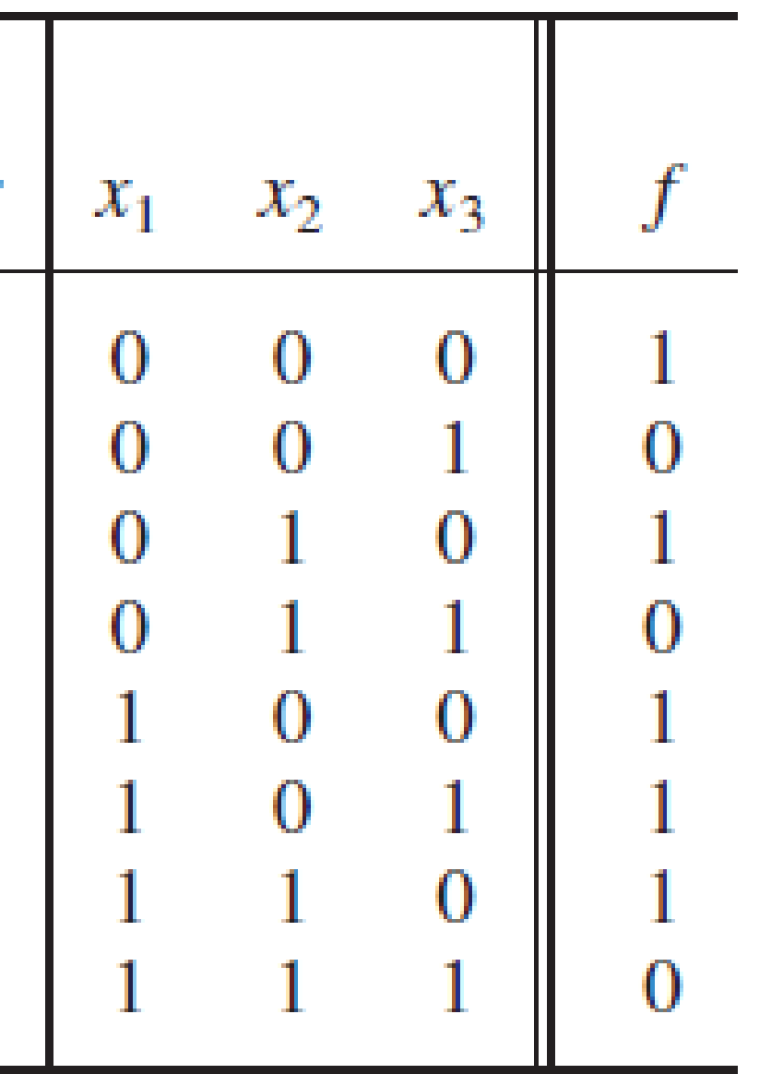
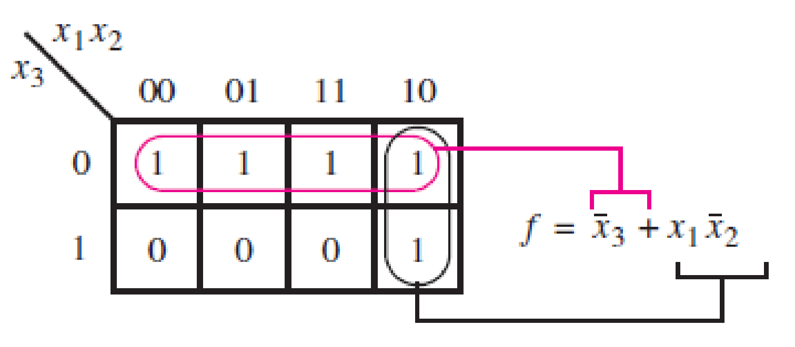

Slide 7
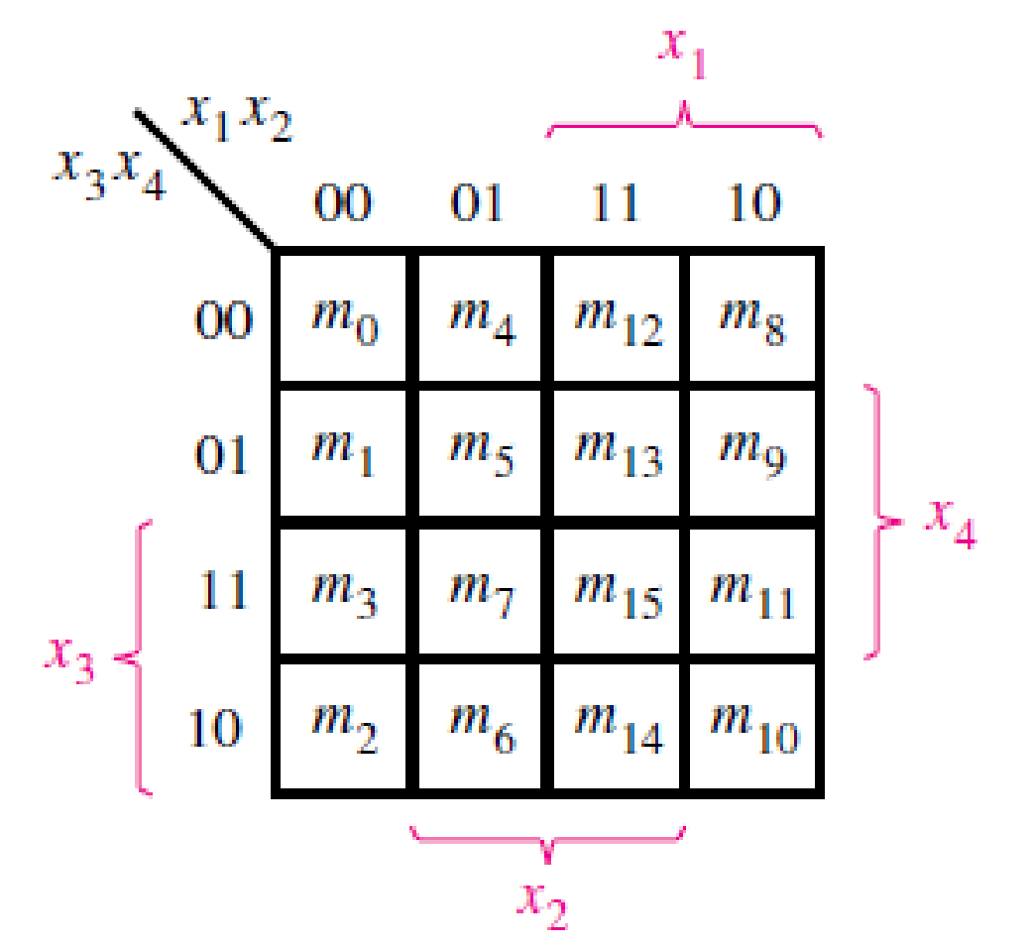
Four-Variable Map

Slide 8
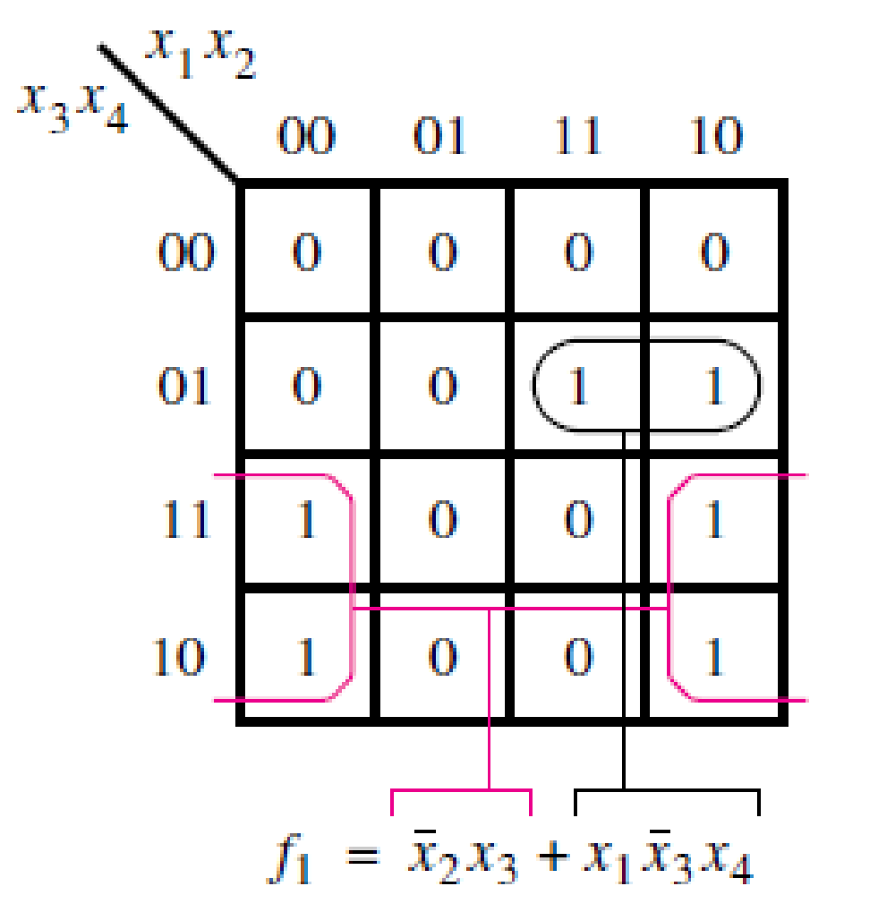

Slide 9
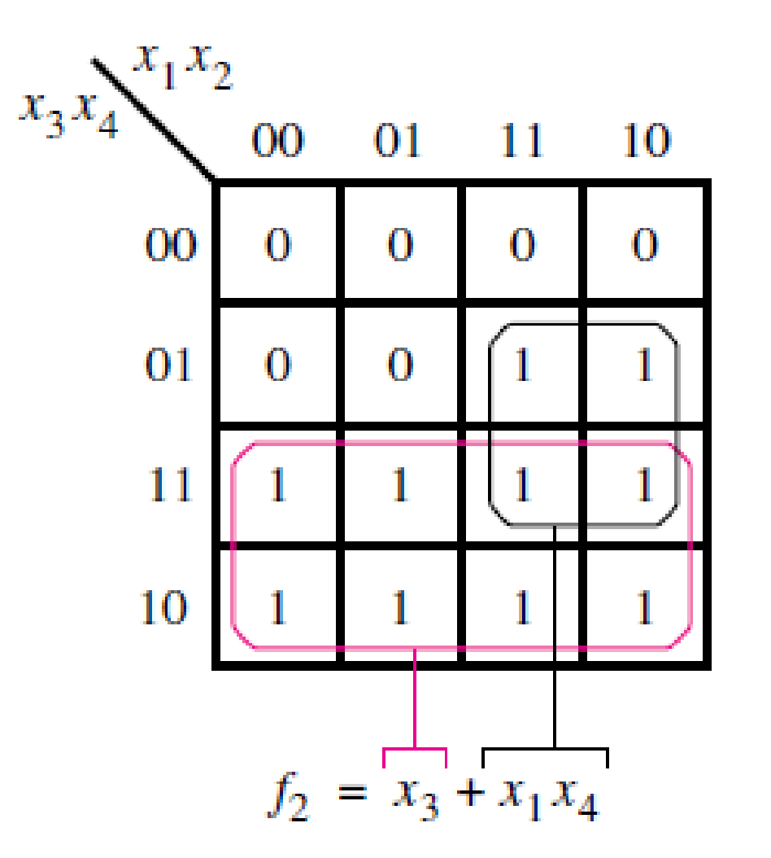

Slide 10
X1, x2
X3, x4
 | 00 | 01 | 11 | 10
00 | 1 | 0 | 0 | 1
01 | 0 | 0 | 0 | 0
11 | 1 | 1 | 1 | 0
10 | 1 | 1 | 0 | 1

Slide 11
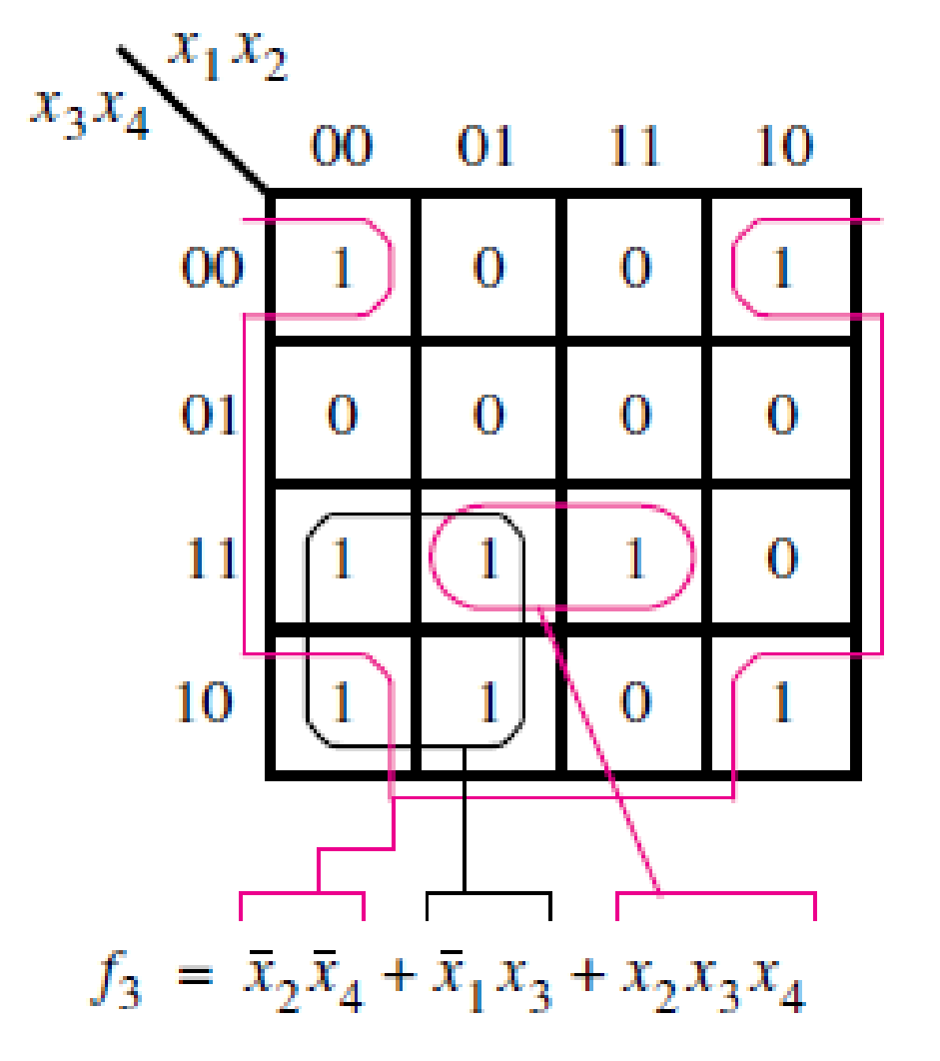

Slide 12
X1, x2
X3, x4
 | 00 | 01 | 11 | 10
00 | 1 | 1 | 1 | 0
01 | 1 | 1 | 1 | 0
11 | 0 | 0 | 1 | 1
10 | 0 | 0 | 1 | 1

Slide 13
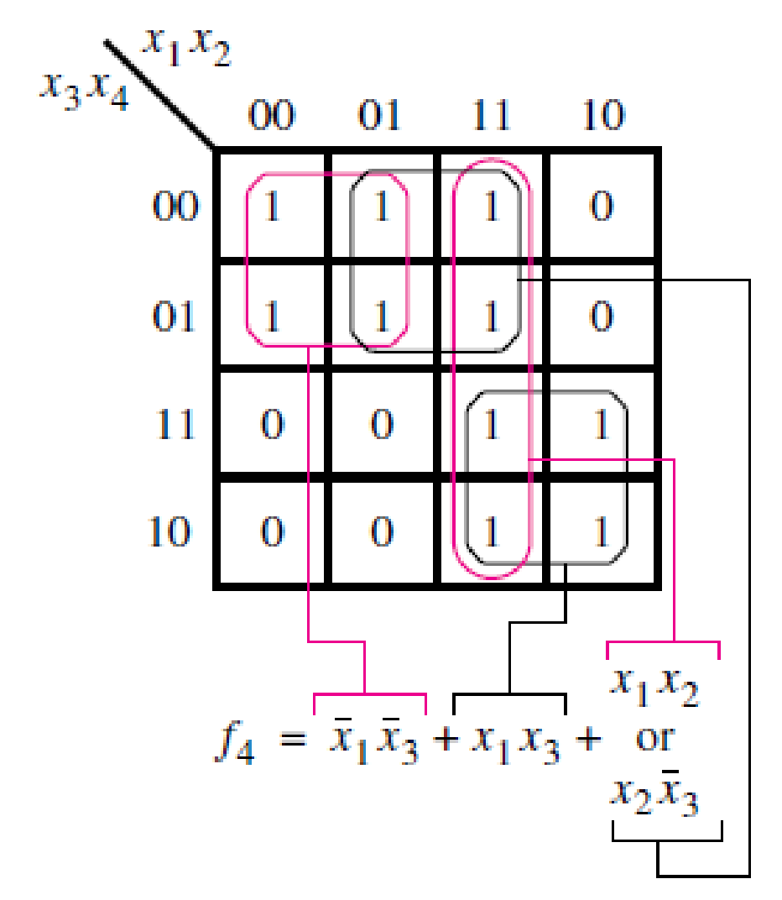

Slide 14

Five-Variable Map
X2, x3
X2, x3
X4, x5
 | 00 | 01 | 11 | 10
00 | 0 | 1 | 1 | 0
01 | 0 | 1 | 1 | 0
11 | 0 | 1 | 1 | 0
10 | 0 | 1 | 1 | 0
X4, x5
 | 00 | 01 | 11 | 10
00 | 0 | 0 | 0 | 0
01 | 1 | 0 | 0 | 0
11 | 1 | 0 | 0 | 1
10 | 1 | 0 | 0 | 1
x1=0
x1=1

Slide 15
Terminology
Some of the terminologies that are useful for describing the minimization process are:
Literal
Each appearance of a variable, either
uncomplemented or complemented, in a logical term is called a literal. For example, the product term x1x2x3
has three literals, and the sum term (x1’+x3+x4’+x6)
has four literals.

Slide 16
Implicant
A product term that indicates the input valuation(s) for which a given function is equal to 1 is called an implicant of the function. The most basic implicants are the minterms.

Slide 17
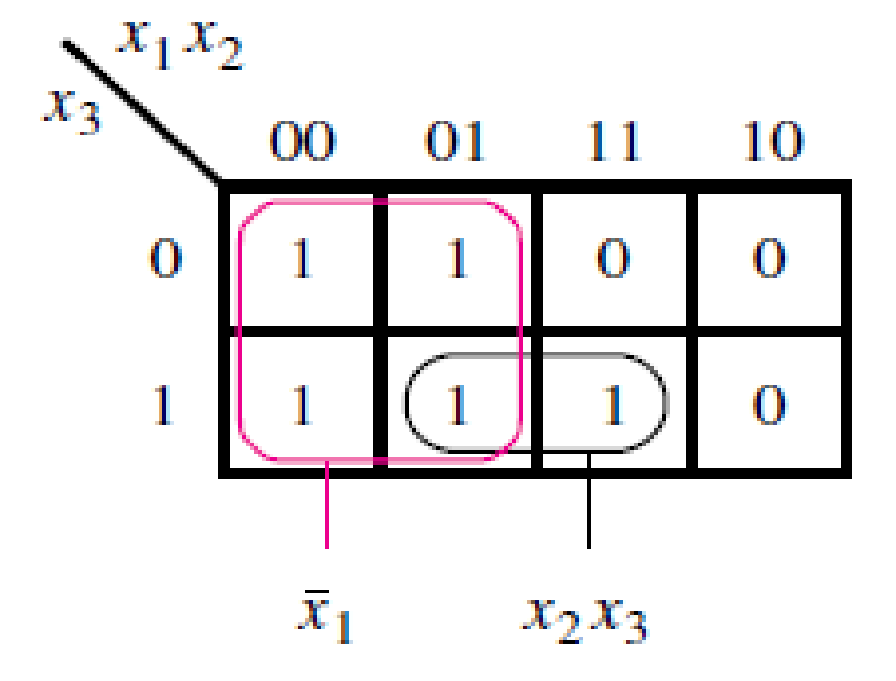
Example:
f (x1, x2, x3) = ∑m(0, 1, 2, 3, 7).
There are 11 implicants for this function:
five minterms: x1’x2’x3’, x1’x2’x3, x1’x2x3’, x1’x2x3, and x1x2x3.
five implicants that correspond to all possible pairs of minterms: x1’x2’ (m0 and m1), x1’x3’ (m0 and m2), x1’x3 (m1 and m3), x1’x2 (m2 and m3), and x2x3 (m3 and m7).
one implicant that covers a group of four minterms: x1’.

Slide 18
Prime Implicant
An implicant is called a prime implicant if it cannot be combined into another implicant that has fewer literals.
Here there are two prime implicants: x1’ and x2x3.

Slide 19
Cover
A collection of implicants that account for all valuations for which a given function is equal to 1 is called a cover of that function.
A number of different covers exist for most functions.
A set of all minterms for which f = 1 is a cover.
A set of all prime implicants is a cover.

Slide 20
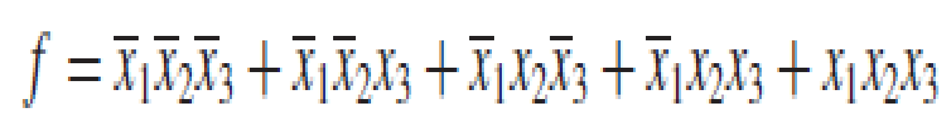
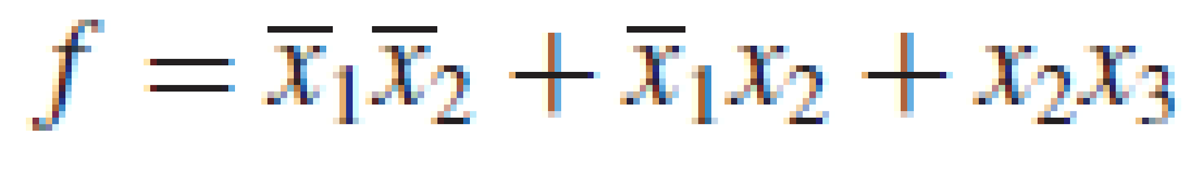
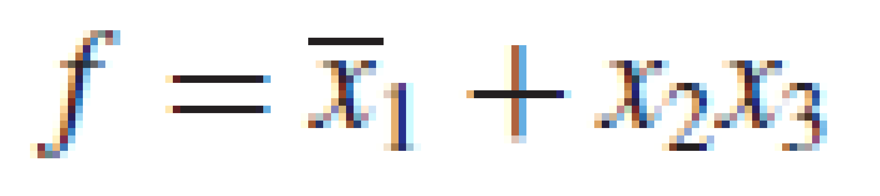
A cover defines a particular implementation of the function.
While all of these expressions represent the function f correctly, the cover consisting of prime implicants leads to the lowest-cost implementation.

Slide 21
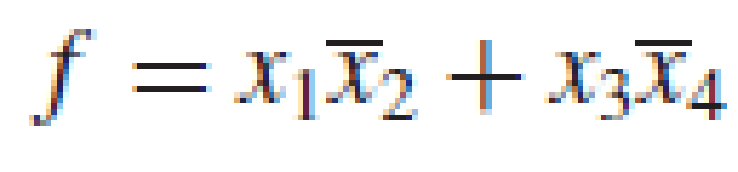
Cost
Cost of a logic circuit is the number of gates plus the total number of inputs to all gates in the circuit.
If we assume that the input variables are available in both true and complemented forms, then the cost of the expression, is 9. Otherwise its cost is 13.

Slide 22
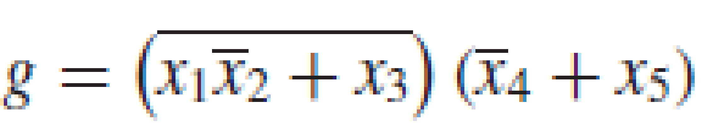
If an inversion is needed inside a circuit, then the corresponding NOT gate and its input are included in the cost. For example, the expression
has a cost of 14.

Slide 23
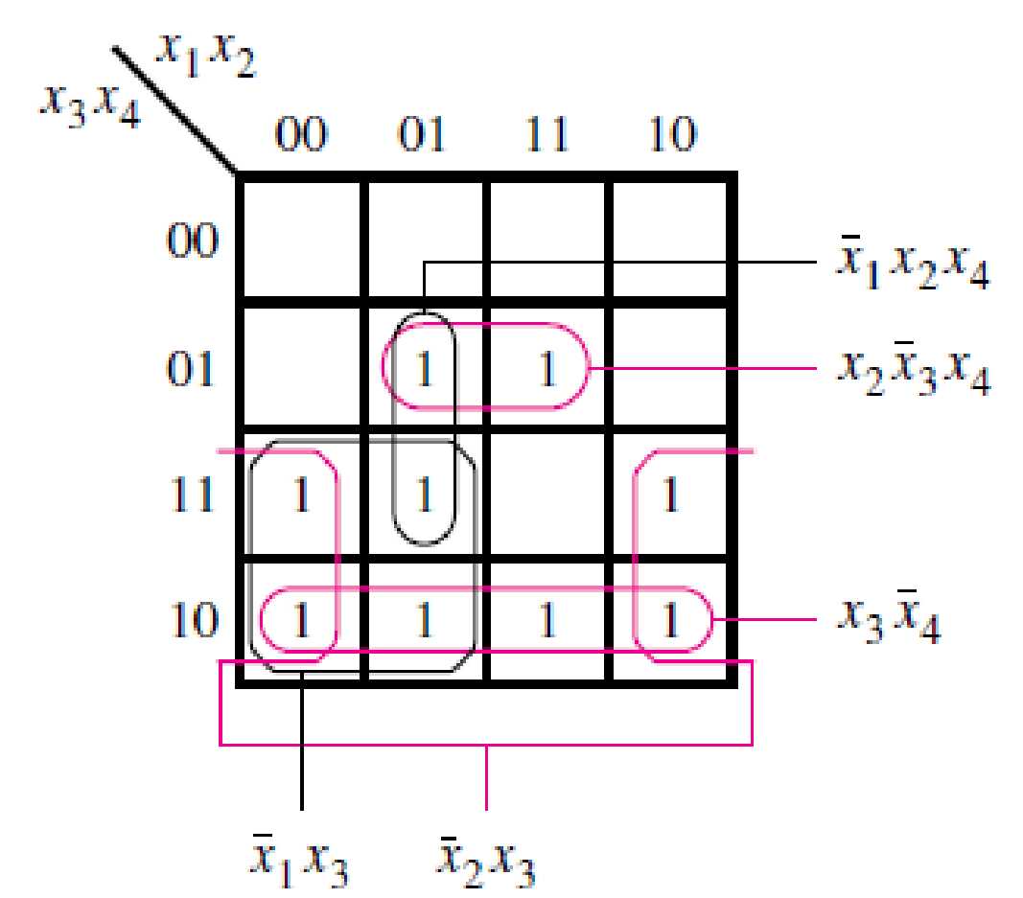
Minimization Procedure
Consider the following examples in which there is a choice as to which prime implicants to include in the final cover
There are five prime implicants: x1’x3, x2’x3, x3x4’, x2x3’x4, x1’x2x4.
The essential ones are x2’x3, (because of m11), x3x4’ (because of m14), x2x3’x4 (because of m13).
They must be included in the cover. These three prime implicants cover all minterms for which f = 1 except m7. It is clear that m7 can be covered by either x1’x3 or x1’x2x4

Slide 24
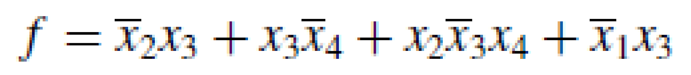
Because x1’x3 has a lower cost, it is chosen for the cover. Therefore, the minimum-cost realization is
The process of finding a minimum-cost circuit involves the following steps:
Generate all prime implicants for the given function f .
Find the set of essential prime implicants.
If the set of essential prime implicants covers all valuations for which f = 1, then this set is the desired cover of f . Otherwise, determine the nonessential prime implicants that should be added to form a complete minimum-cost cover.

Slide 25
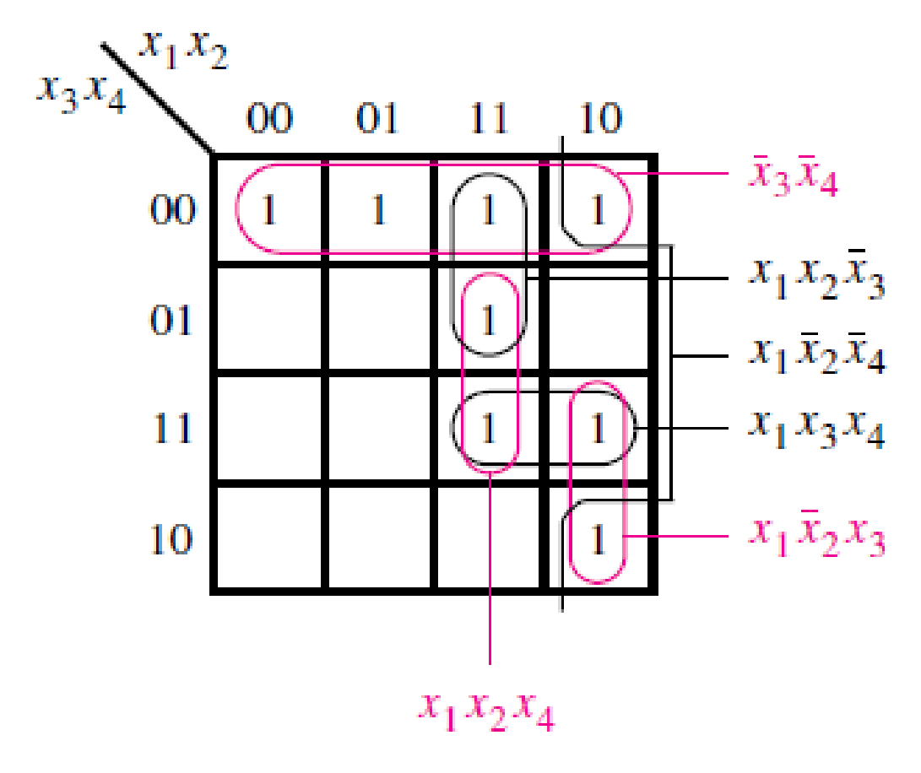
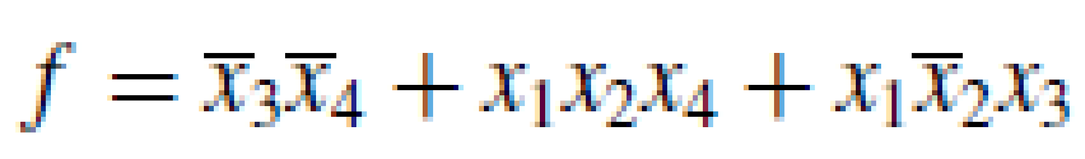
Consider the following example:
only x3’x4’ is essential.
Then the best choice to implement the minimum cost circuit is

Slide 26
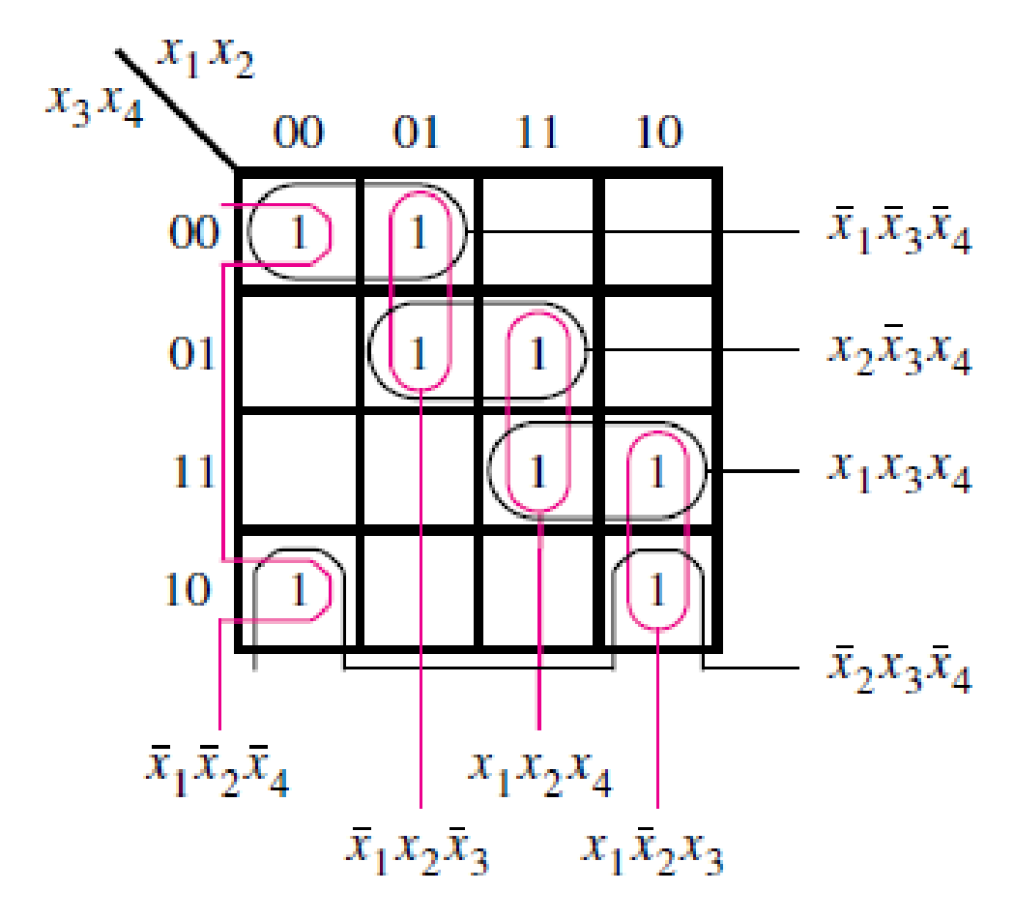
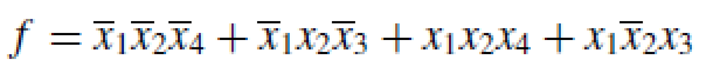
Sometimes there may not be any essential prime implicants at all. Example:
Two alternatives:

Slide 27
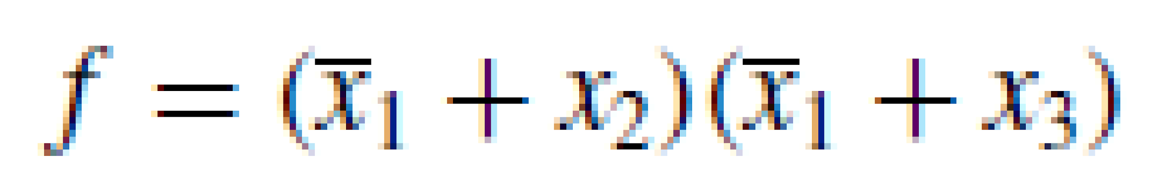
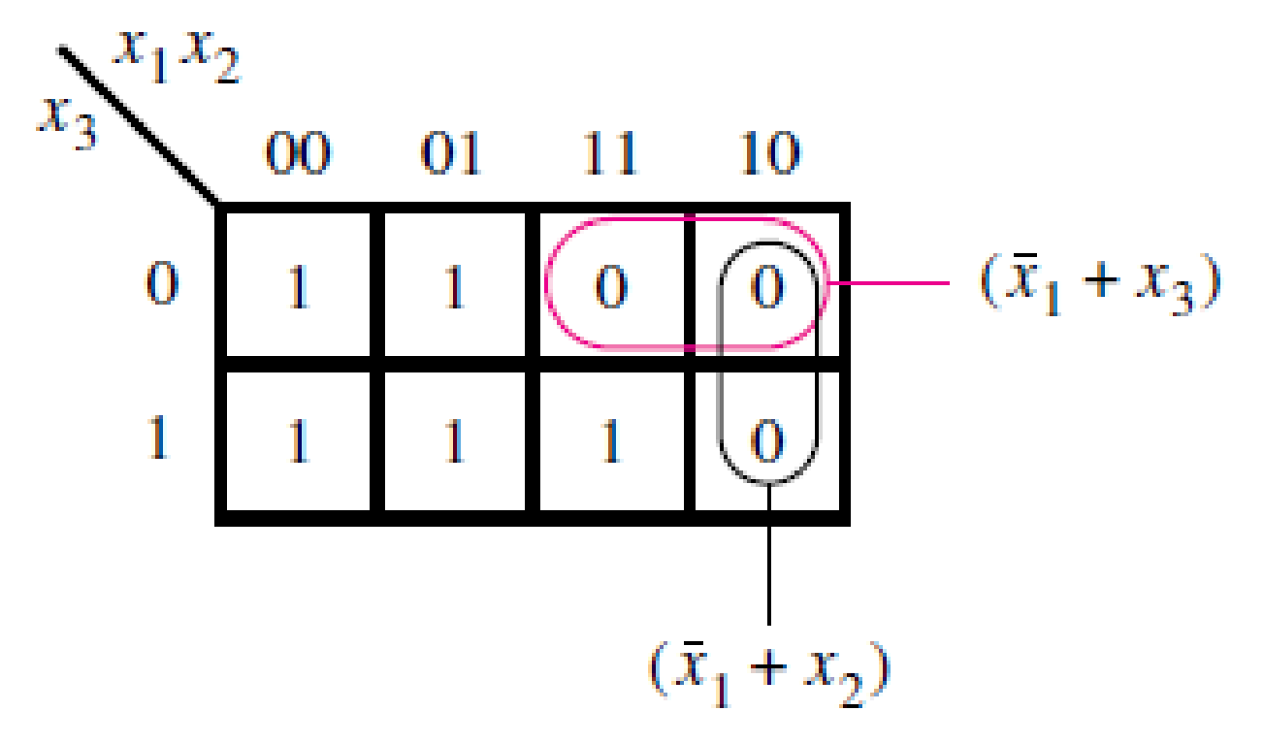
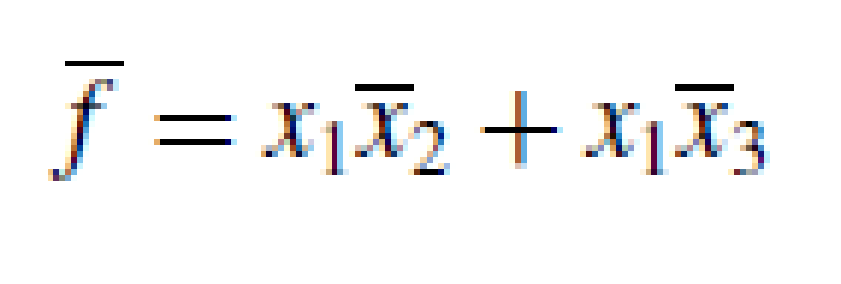
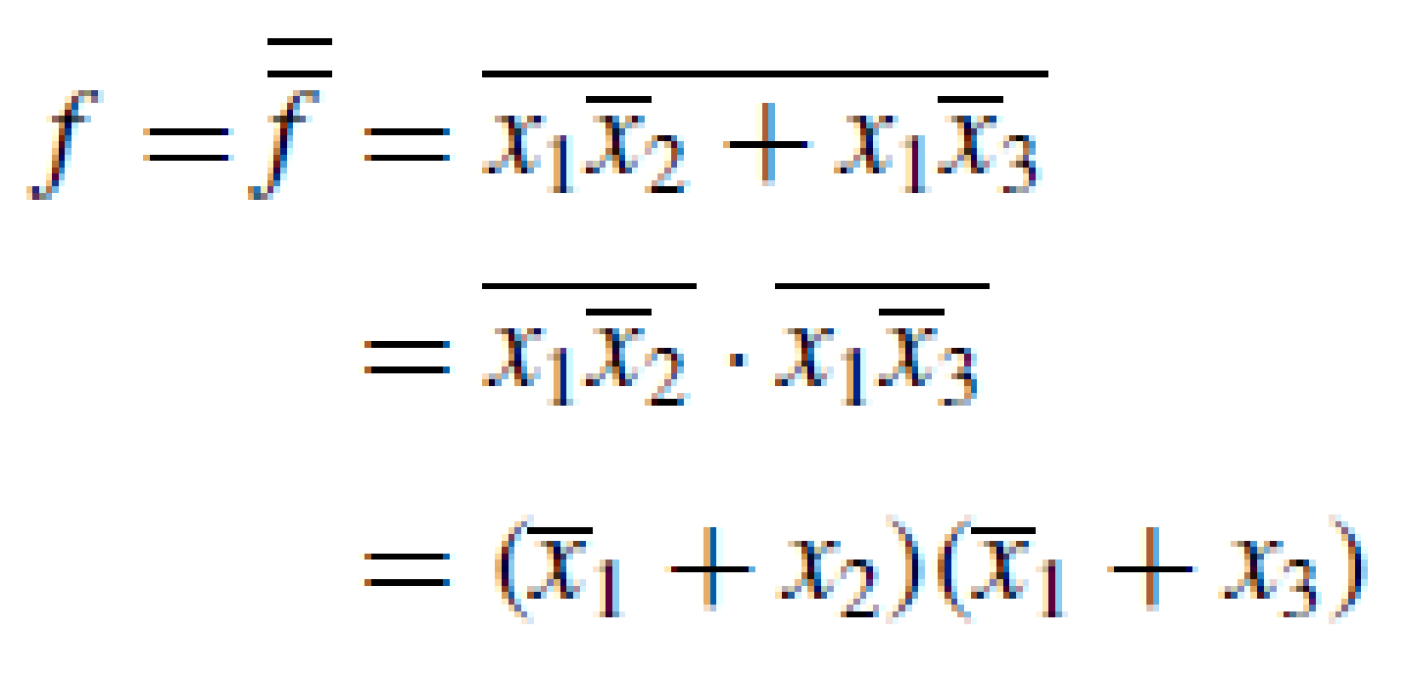
Minimization of Product-of-Sums Forms
Example1:
OR

Slide 28
Its cost is greater than the cost of the equivalent SOP implementation
SOP COST: 6 (assuming input variables are available in both true and complemented forms)
POS COST: 9

Slide 29
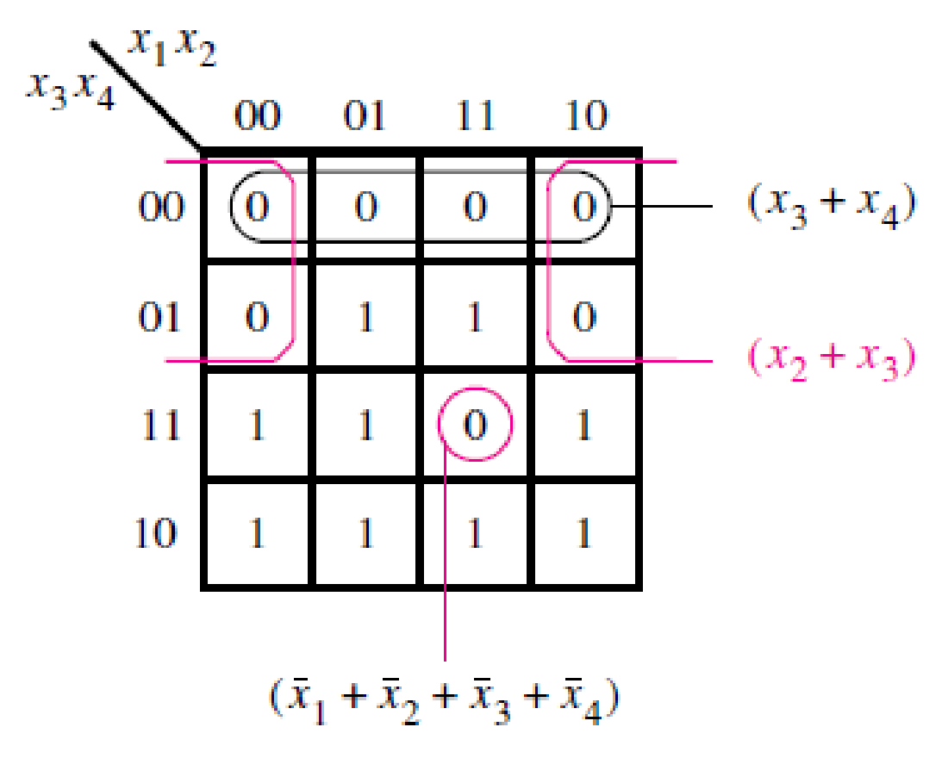
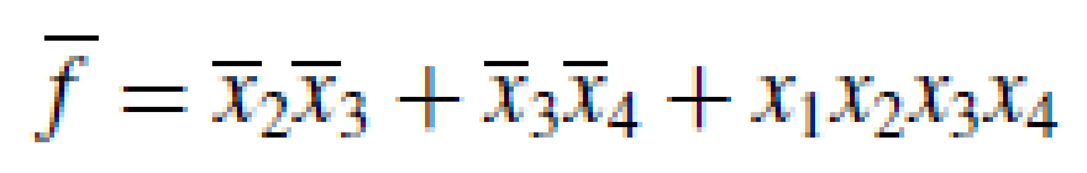
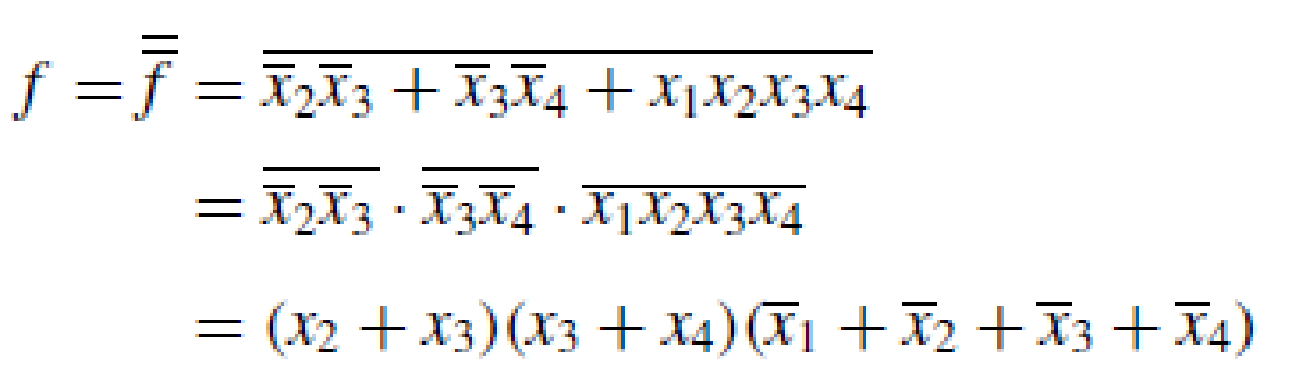
Example2:
OR

Slide 30
Assuming that both the complemented and uncomplemented versions of the input variables x1 to x4 are available,
SOP COST: 18
POS COST: 15
SOP and POS implementations of a given function may or may not entail the same cost.

Slide 31
EXERCISES:
Find the POS implementation for the following and compare the cost with the SOP form
1.
2.

Slide 32
SOP:
OR
Cost: 3 input AND gate: 4🡪 12+4=16
4 input OR gate: 1 🡪 4+1=5
cost = 21
POS:
(x1’+x2+x3)(x1’+x2’+x4)(x1+x2’+x3’)(x1+x2+x4’)
OR
(x1’+x3+x4)(x2+x3+x4’)(x1+x3’+x4’)(x2’+x3’+x4)
Cost: 3 input OR gate: 4🡪 12+4=16
4 input AND gate: 1🡪 4+1=5
cost = 21

Slide 33
2. SOP:
cost: 2 input AND gate 1🡪 2+1 = 3
3 input AND gate 2🡪 6+2 = 8
3 input OR gate 1🡪 3+1 = 4
cost = 15
POS:
(x1+x4’)(x1+x3’)(x2+x3+x4’)(x2’+x3’+x4)
Cost: 19

Slide 34
1. Obtain the simplest SOP and POS for f (x1, . . . , x5) =∏ M(1, 4, 6, 7, 9, 12,15, 17, 20, 21, 22, 23, 28, 31).
X2, x3
X2, x3
X4, x5
 | 00 | 01 | 11 | 10
00 | 1 | 0 | 0 | 1
01 | 0 | 1 | 1 | 0
11 | 1 | 0 | 0 | 1
10 | 1 | 0 | 1 | 1
X4, x5
 | 00 | 01 | 11 | 10
00 | 1 | 0 | 0 | 1
01 | 0 | 0 | 1 | 1
11 | 1 | 0 | 0 | 1
10 | 1 | 0 | 1 | 1
x1=0
x1=1

Slide 35
Incompletely Specified Functions
In digital systems it often happens that certain input conditions can never occur. For example, suppose that x1 and x2 control two interlocked switches such that both switches cannot be closed at the same time. Then the input valuations (x1, x2) = 11 is guaranteed not to occur. Then we say that (x1, x2) = 11 is a don’t-care condition, meaning that a circuit
with x1 and x2 as inputs can be designed by ignoring this condition. A function that has don’t-care condition(s) is said to be incompletely specified.

Slide 36
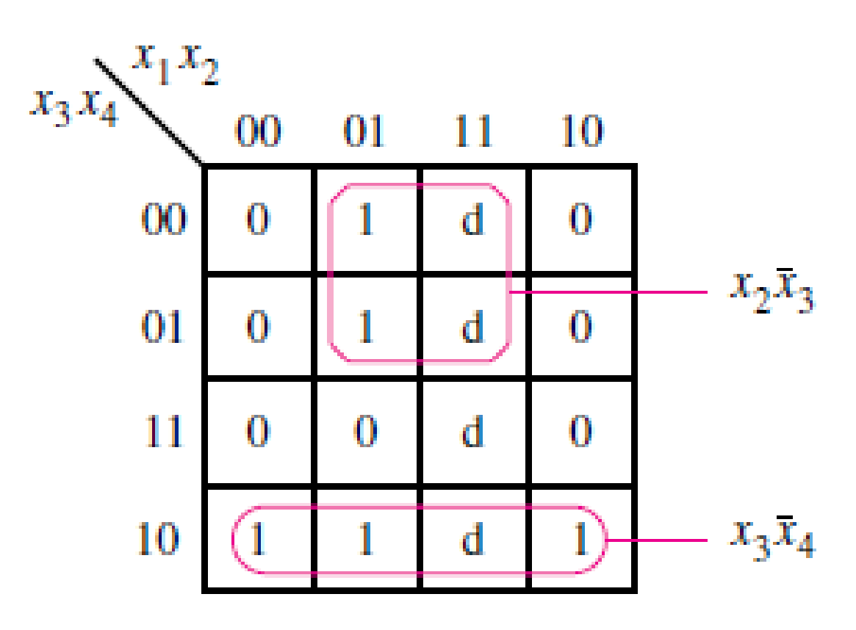
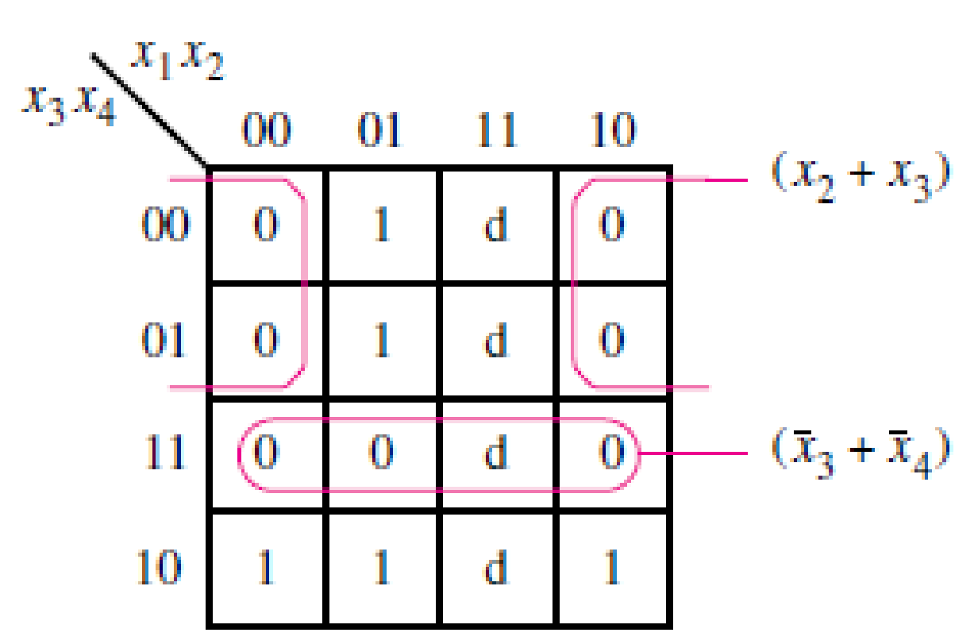
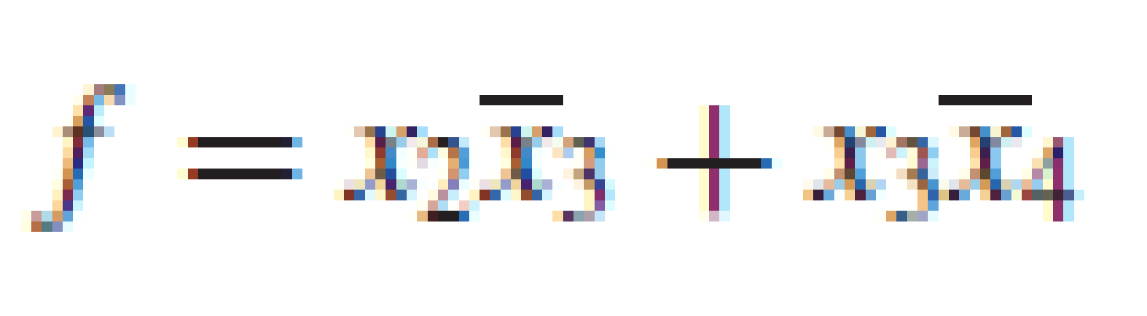


Slide 37
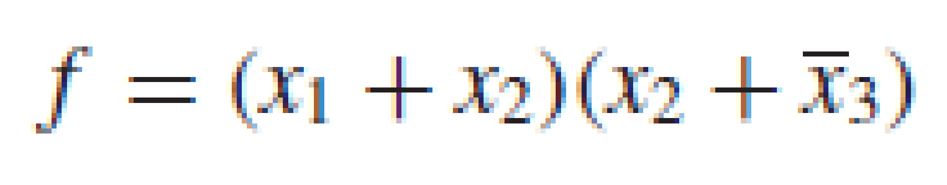
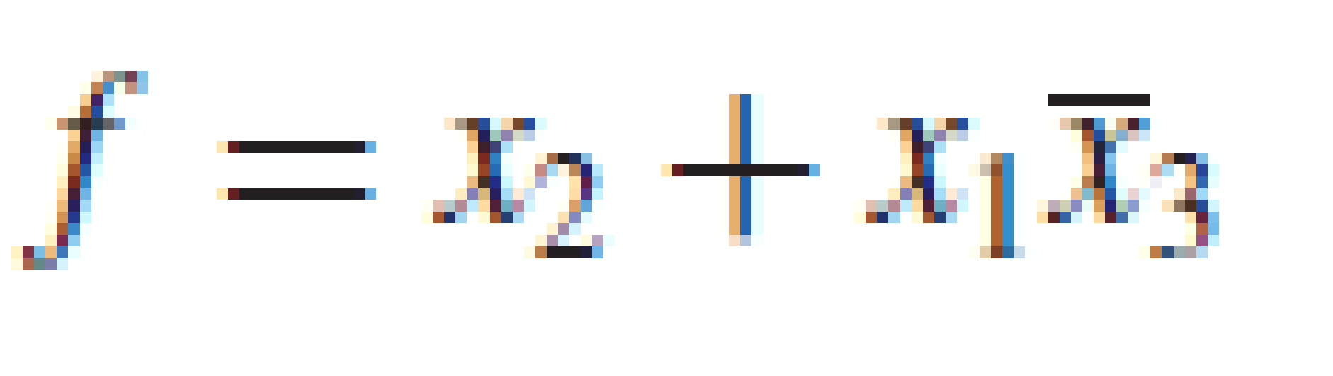
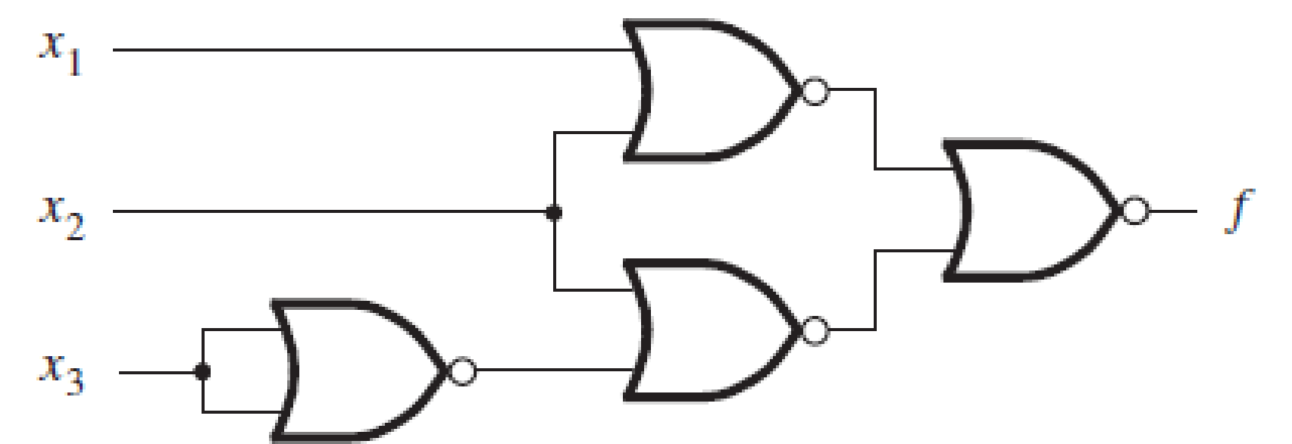
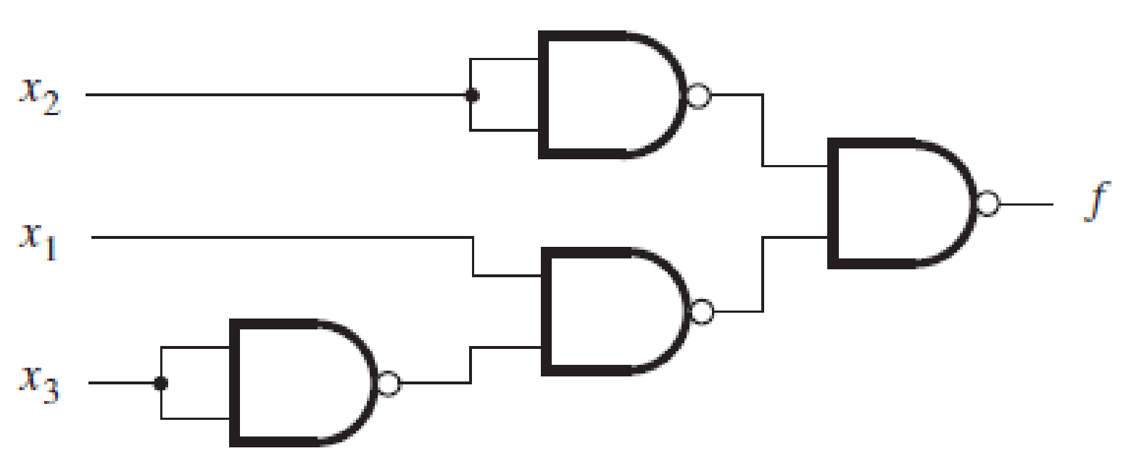
NAND and NOR Implementation

Slide 38
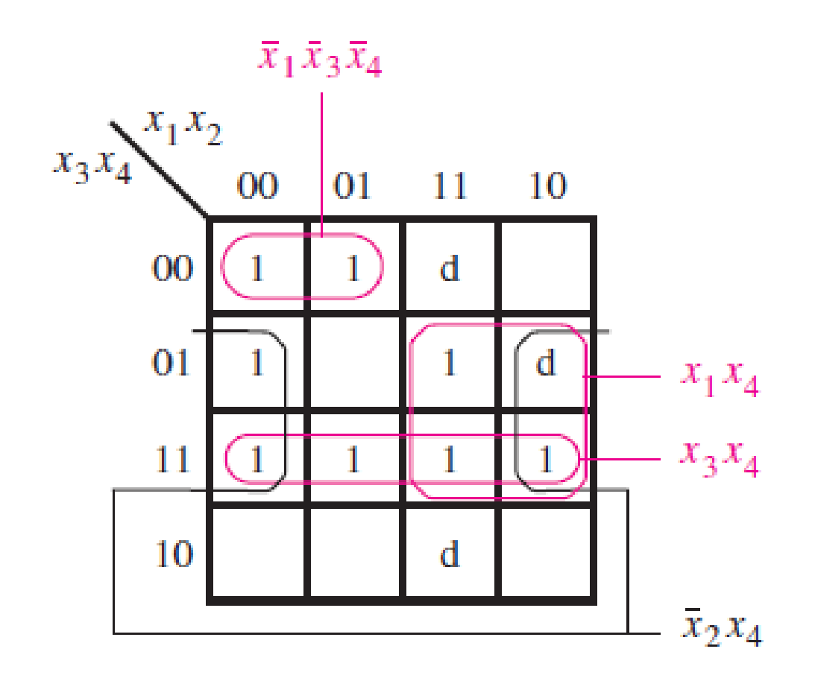
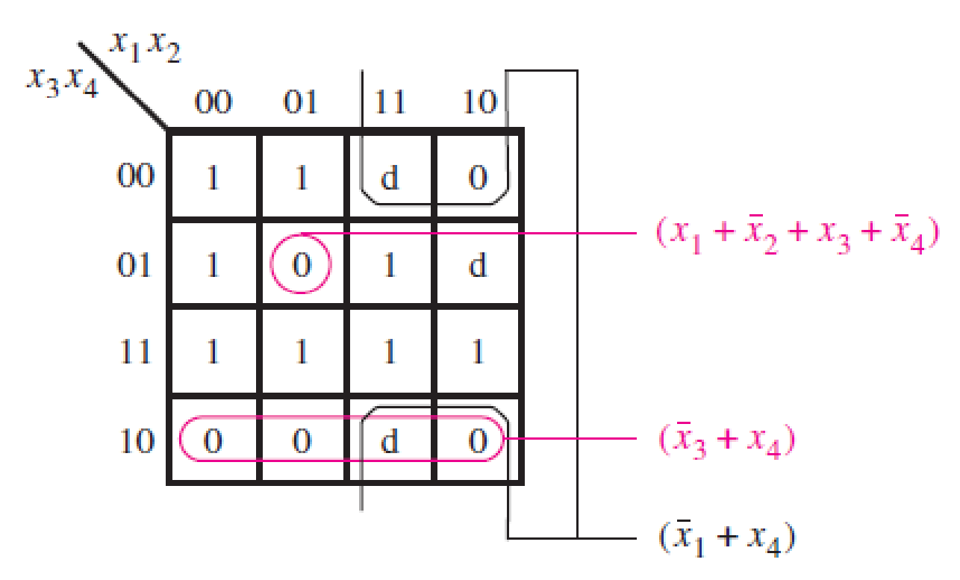

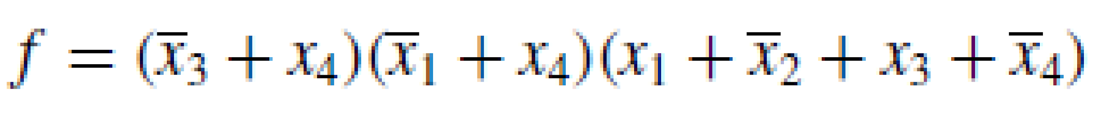
Use Karnaugh maps to find the minimum-cost SOP and POS expressions for the function
f (x1, . . . , x4) = x1’x3’x4’ + x3x4 + x1’x2’x4 + x1x2x3’x4
assuming that there are also don’t-cares defined as D = ∑(9, 12, 14).

Slide 39
A three-variable logic function that is equal to 1 if any two or all three of its variables are equal to 1 is called a majority function. Design a minimum-cost SOP circuit that implements this majority function.
a | b | c | f
0 | 0 | 0 | 0
0 | 0 | 1 | 0
0 | 1 | 0 | 0
0 | 1 | 1 | 1
1 | 0 | 0 | 0
1 | 0 | 1 | 1
1 | 1 | 0 | 1
1 | 1 | 1 | 1

